Slide 1
Year 2 Autumn ‘23
Dr D Wilson - diane.wilson@qub.ac.uk
Dr A McVeigh – a.mcveigh@qub.ac.uk

Slide 2
Year 2 Students’ Clinical Skills Teaching to date
Year 1
CSEC face to face teaching Autumn & Spring
3 Spring “Attachment” Clinical experience sessions – online & histories
Students have passed an 8 station summative OSCE at the end of year 1
Also Family Attachment and Clinical Communication Skills

Slide 3
Year 2 Student`s Clinical Skills AUTUMN 23
6 CSEC teaching sessions
5 afternoons teaching in GP Practice or Hospital
1 Self-directed learning (SDL) session – timetabled and supervised

Slide 4
Outline of Clinical Teaching in GP/Hospital
You have 10 timetabled teaching weeks
Your students have been divided into 2 groups each with 4 - 5 students
These groups will alternate and attend the GP or Hospital 5 times.
  Their FIRST EXPERIENCE of HOSPITAL or GP TEACHING
  ….. and possibly REAL PATIENTS
Notes:
As detailed later – you will Teach the same topic for 2 weeks

Slide 5
 | MONDAY dates | THURSDAY dates
Session 1 | 25 Sept | 28 Sept
 | 2 Oct | 5 Oct
Session 2 | 9 Oct | 12 Oct
 | 16 Oct | 19 Oct
Session 3 | 23 Oct | 26 Oct
 | 30 Oct | 2 Nov
Session 4 | 6 Nov | 9 Nov
 | 20 Nov | 23 Nov
Session 5 | 27 Nov | 30 Nov
 | 4 Dec | 7 Dec

Slide 6
Content of the GP /Hospital Clinical Teaching
Focus on practise of skills in the real setting
Try to involve at least 2 real patients in each session
Includes NEW skills and skills previously taught in CSEC
Expect prior preparation by students for these sessions – their student information is on CANVAS - consider “homework”
Notes:
Resources which are required are linked in the summary

Slide 7
TIMETABLE - Clinical Skills Experience : 2nd year Autumn Semester 2023
Attendance at the allocated HOSPITAL or GP PRACTICE
Session | TOPIC
1 | Introductions and orientation to clinical setting. *NEW* GI history taking Examination of praecordium Respiratory examination
2 | *NEW* Urinary History taking Examination of the GI system
3 | *NEW Diabetic history taking Examination of Peripheral Pulses Measurement of BP
4 | *NEW Gynaecological history Ear Examination Cranial nerve examinations
5 | *NEW Headache and Collapse histories Motor and Sensory examinations

Slide 8
Resources for Y1+2 Clinical Experience
Summary for Clinical Skills Teachers Spring 23
Contacts, Timetables, Relevant website links, Suggestions
Clinical Skills website https://www.med.qub.ac.uk/portal/Account/Login.aspx
Full details of Clinical Skills, DOCS proformas
Quick Reference Guide QRG (now also available in e-format on Clinical Skills website)

Slide 9
Feedback
Give immediate verbal feedback
Consider using DOCS
NEW Mini- CEX forms - ‘My Progress’
Optional this year but encouraged as a useful learning tool.
Online Mini-CEX forms are on the students phone - completed live
Notes:
NEW *** Mini- CEX forms on the student ‘My Progress’ app ***
This year the medical students` portfolio platform has changed to “My Progress”. This now includes the ability to have online forms, called Mini-CEX forms, which students will keep on their phone app.
These are optional but encouraged for this group of Year 2 students and they will have been highlighted to students as a useful learning tool.
The online Mini-CEX forms are the same as the DOCS forms in structure, however they need to be completed live, and not retrospectively.

Slide 10
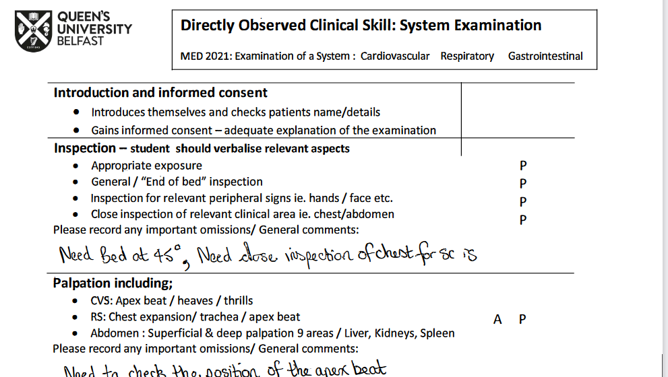
https://www.med.qub.ac.uk/portal/cskills/students/DOCS.aspx
Feedback tools and ** NOT OSCE MARKING SHEETS **

Slide 11
Exceptional Circumstances
Keep contact details for the group – student representative
In exceptional circumstances, you may need to use an alternative date to deliver a teaching session - Monday 11 & Thursday 14 December
Attendance
100% attendance at these sessions is expected. Please keep a record of attendance. Contact CSEC staff if a student misses more than 1 session.
In the case of illness, please allow students to swap within their group to maximise these face to face teaching opportunities.
Should you have any specific concerns regarding any student within your group or issues with attendance, it is important you contact CSEC staff and bring it to their attention as soon as possible.

Slide 12
THANK YOU
and
Enjoy!

Slide 13

End slide

